Slide 1
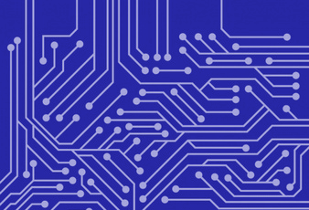

Machine Learning Based Temperature and Lighting Controller
Smart Sensors and Controls for
Residential Buildings
James Whitfield - Dual Degree Engineering (Computer Science)
Destiny Currie - Dual Degree Engineering (Industrial Engineering/Mathematics)
Clark Atlanta University (Atlanta, GA). 2019
Academic Mentor: Dr Olu Olatidoye

Slide 2


Students select a challenge:
Smart Sensors
Air Distribution
Wall Retrofit
Identify community impacted by the problem
Describe the challenge
Jump Into Stem
Brainstorm possible solutions
Plan a solution for the selected problem

Slide 3
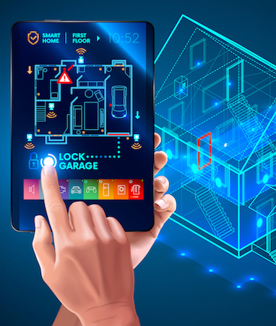
Smart Sensors / Residential Building Controls
“Develop an innovative solution that uses sensor data in residential buildings to reduce energy use, improve occupant comfort, and/or increase grid responsiveness”
Internet of Things (IoT)
Smart appliances
Communication
Integrated controls for sensors/technology

Slide 4
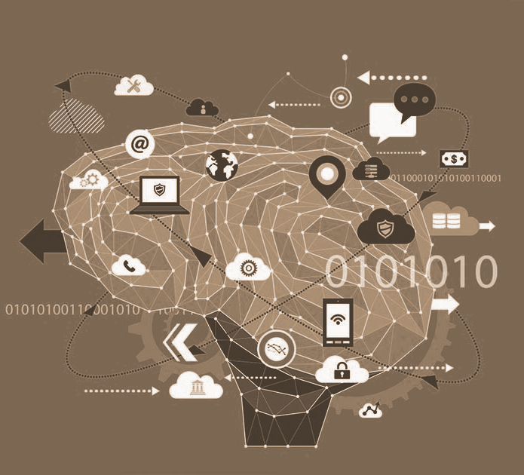
Market Research
Integrated systems/controls needed
Improve energy efficiency
Open more possibilities
Sharing data
Communication
Ex: Smart microwave can send a prompt to a smart tv when food is done
Smart device market surging
IoT Market
5.8 billion endpoints
21% increase
Brands/Companies
Compatibility

Slide 5
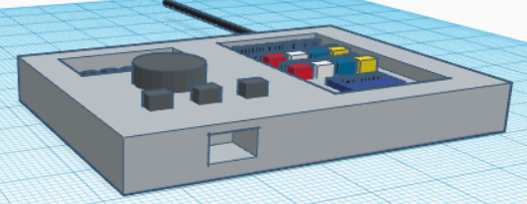
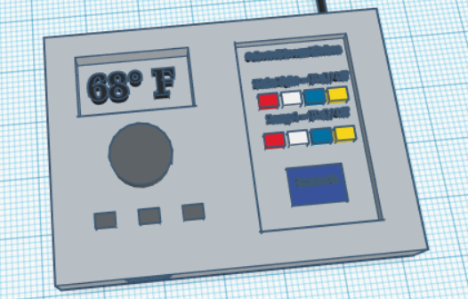
The TL Controller
Thermostat / Light Controller
Controls BT smart lights
Controls Thermostat
Mobile App / Web App
Real time controls
Prompts
Recommendations
Artificial Intelligence
Automatic
Machine Learning
Improves over time
Energy Efficiency
Software Based
Dynamic
Updates

Slide 6
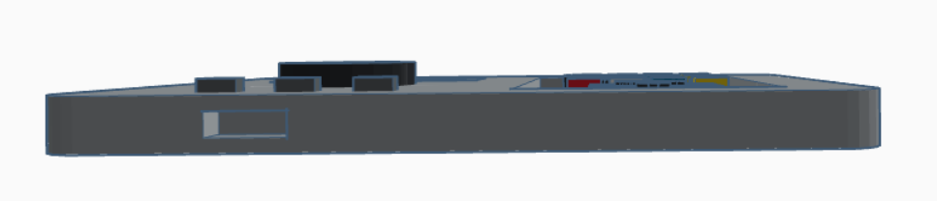
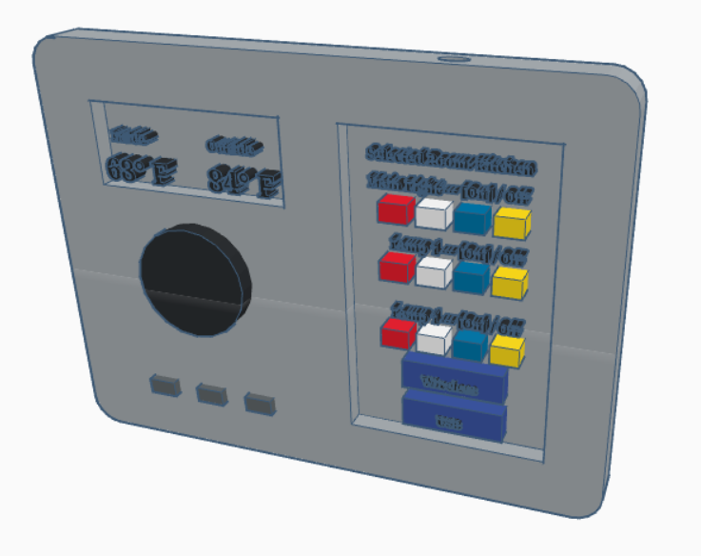
EDITS
Curved Edges
Defined Dimensions
20cm x 15cm x 2cm
More info on temperature display
Wireless & USB options

Slide 7
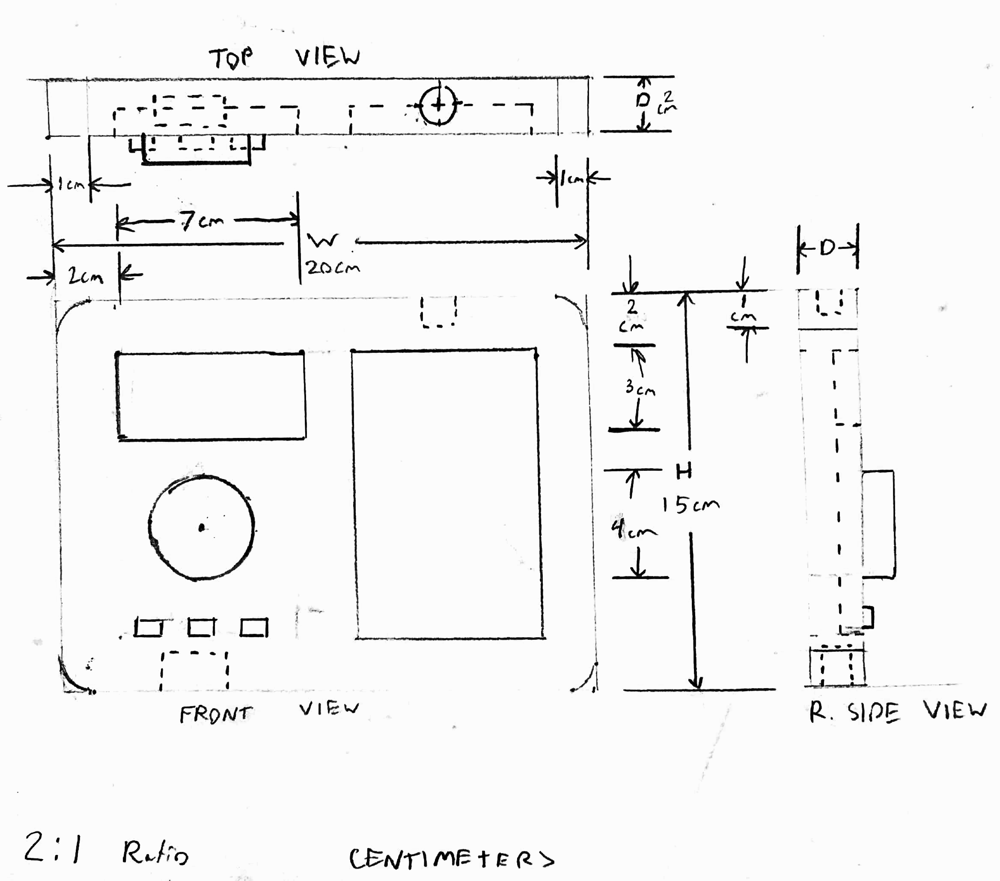
TARGET
Smart device owners
Noticed high electric bills
Own multiple brands
People looking to switch over
Home owners
Cut down energy costs
Monitor light/thermostat usage
L

Slide 8

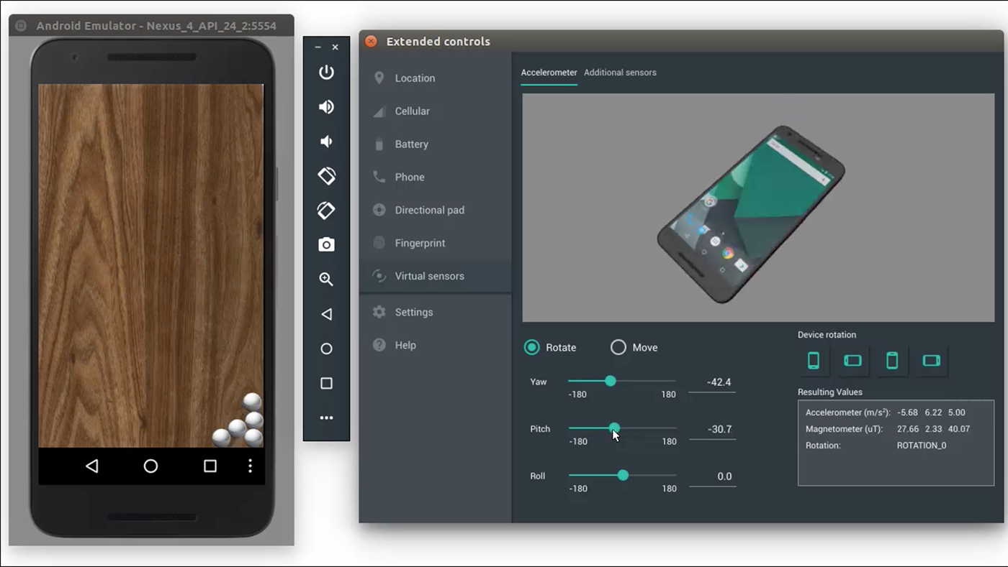
Mobile Application
Development
Android Studio
Java
MySQL Database
PHP
Android Debugging
Full Control
Real time changes
Informative Prompts
Energy Efficiency
Cost Calculation

Slide 9
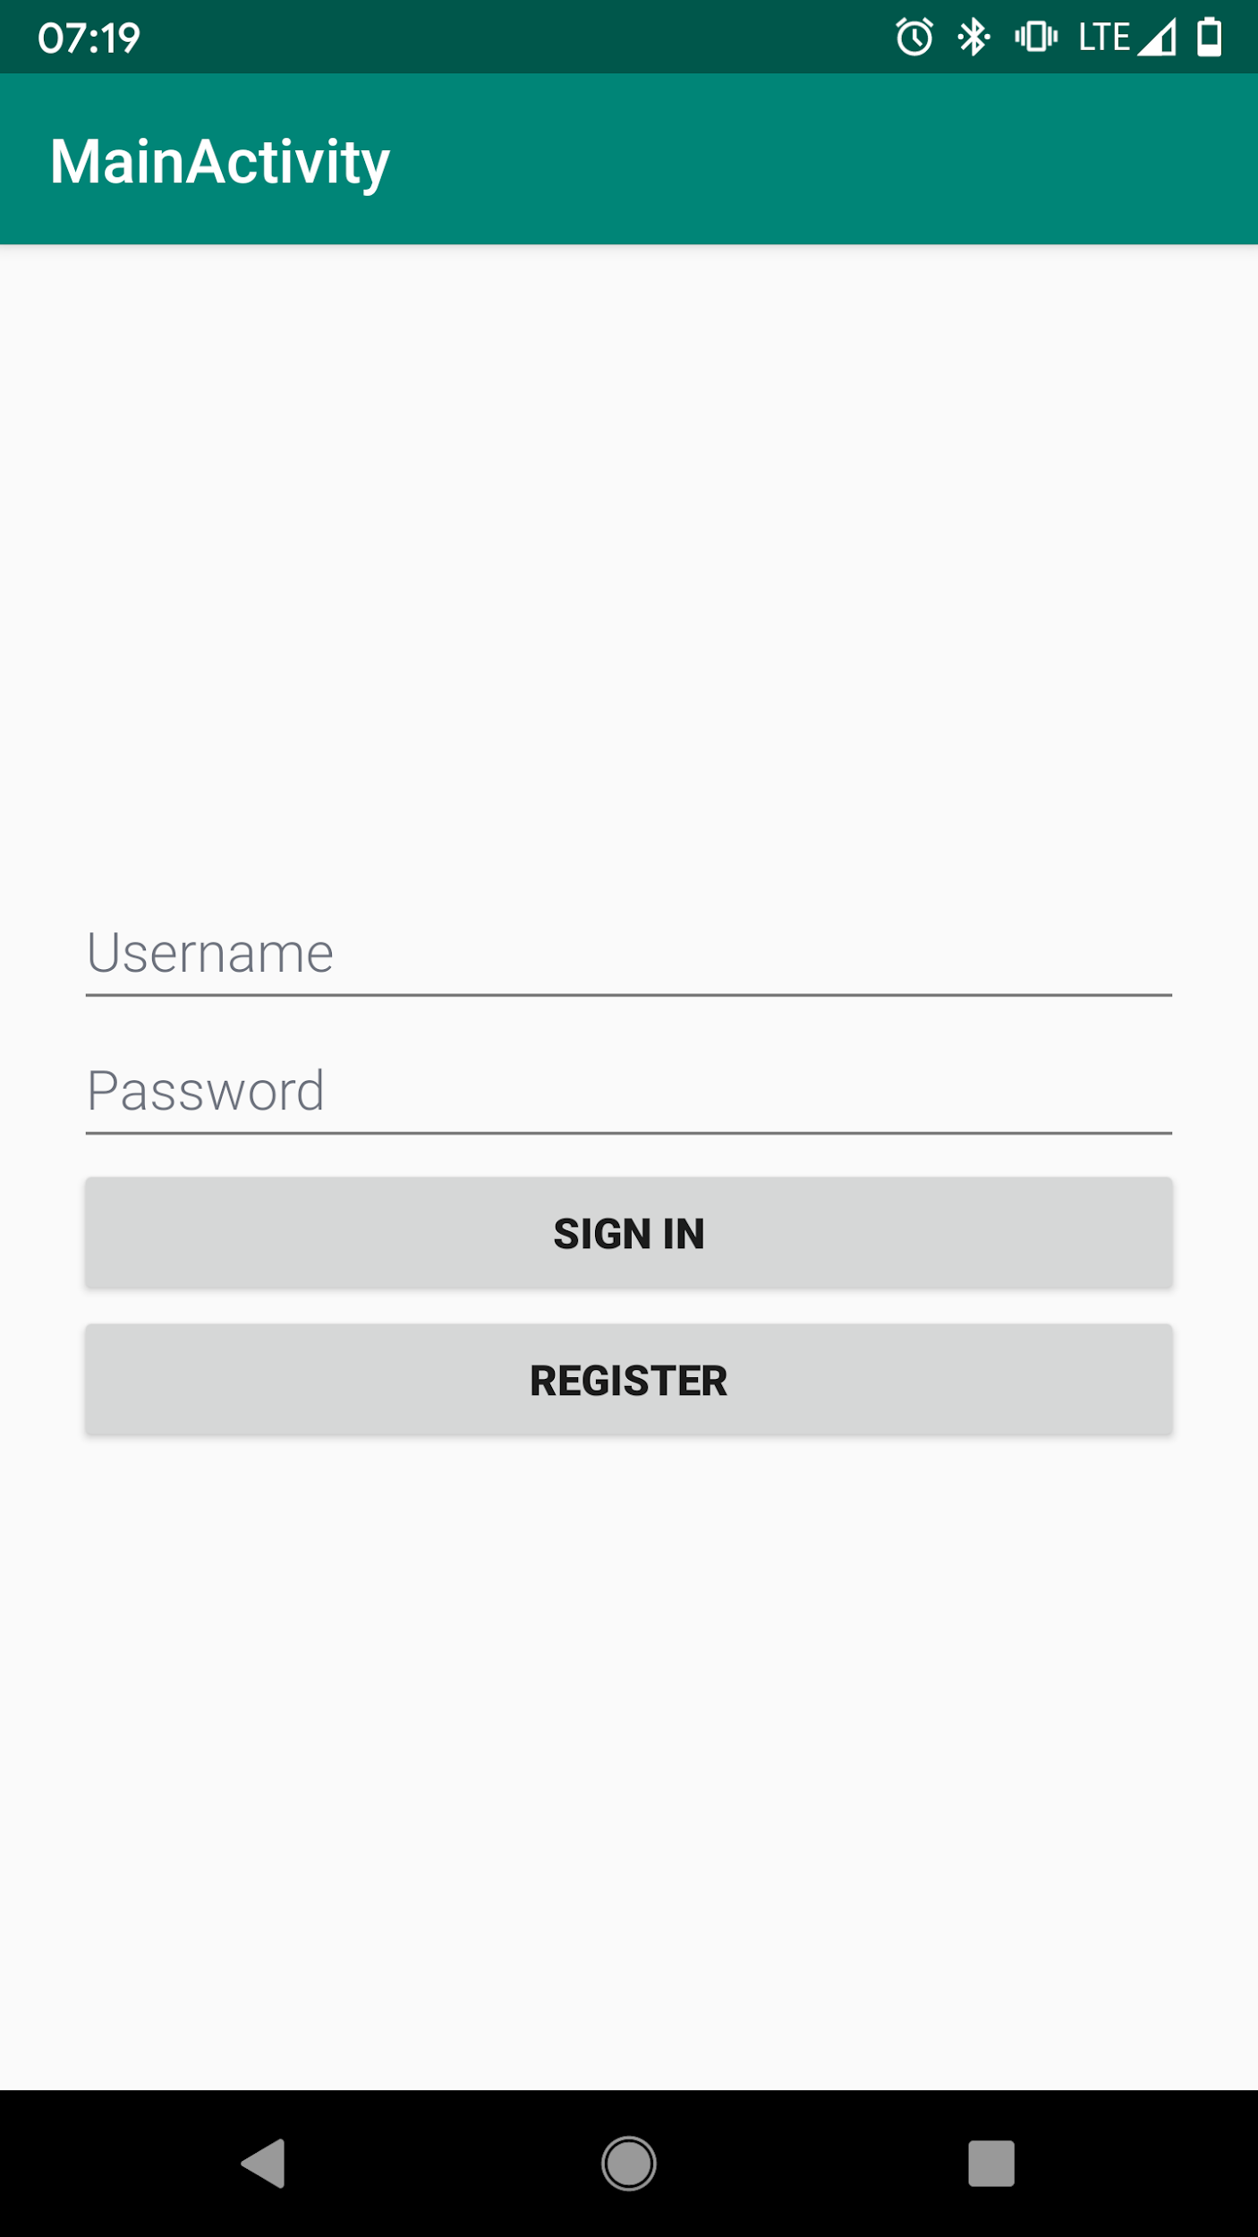
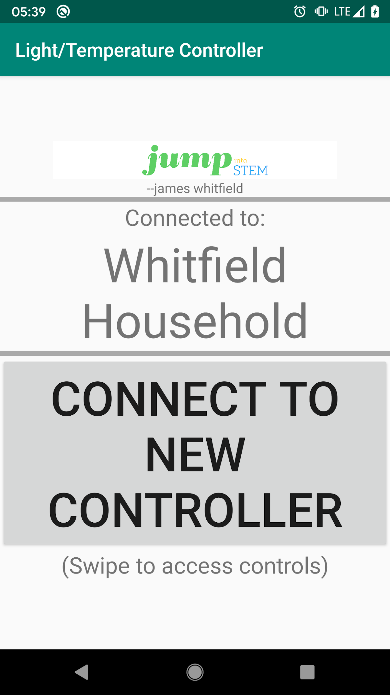
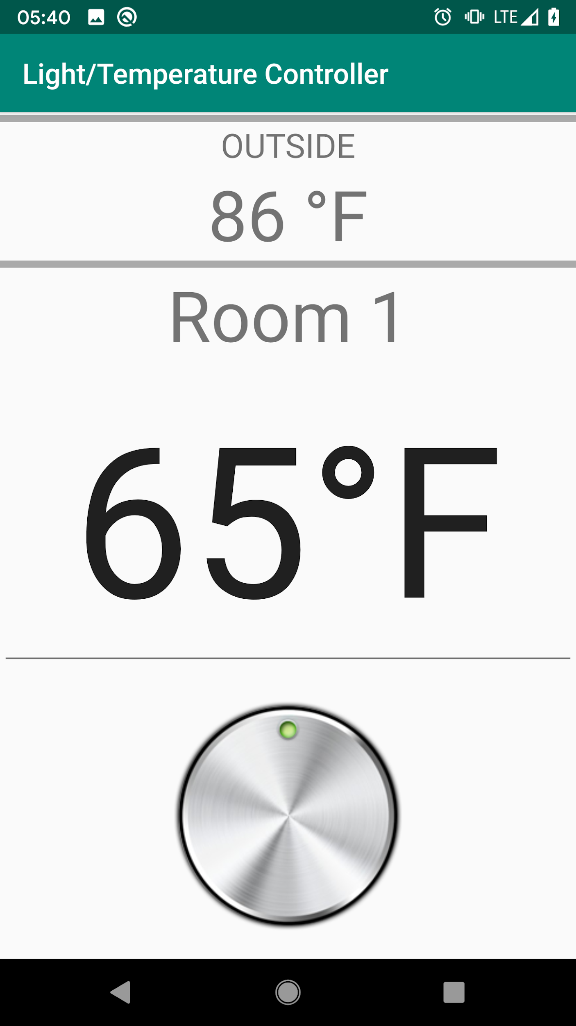
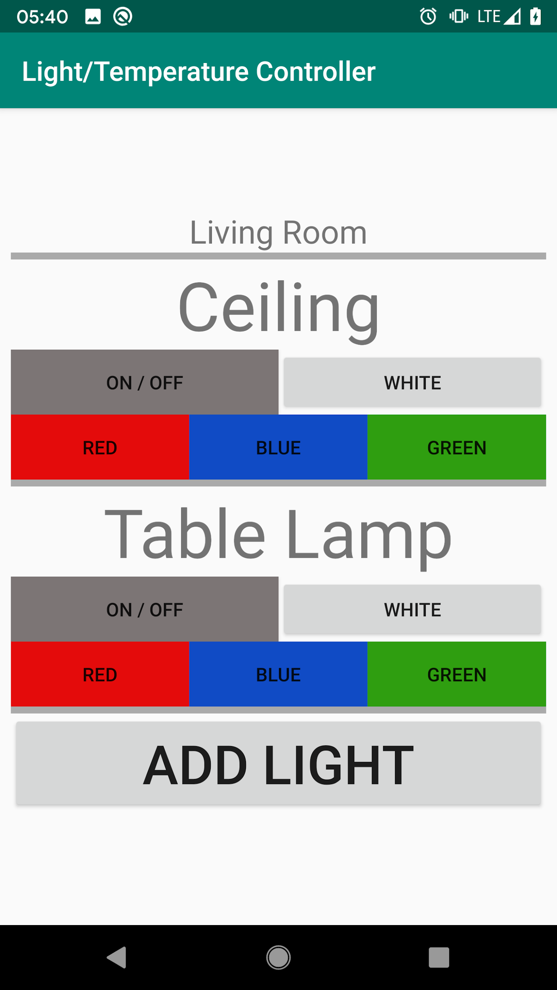

Slide 10
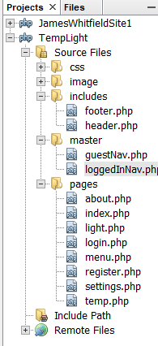
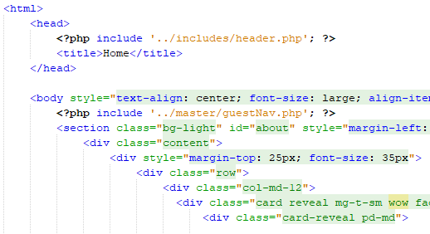


Web Application
PHP/HTML
Netbeans
Bootstrap
Responsive
MySQL Database
Xampp
Direct Control
Real time changes
Artificial Intelligence
Settings
Editing
Rooms, Lights, etc

Slide 11
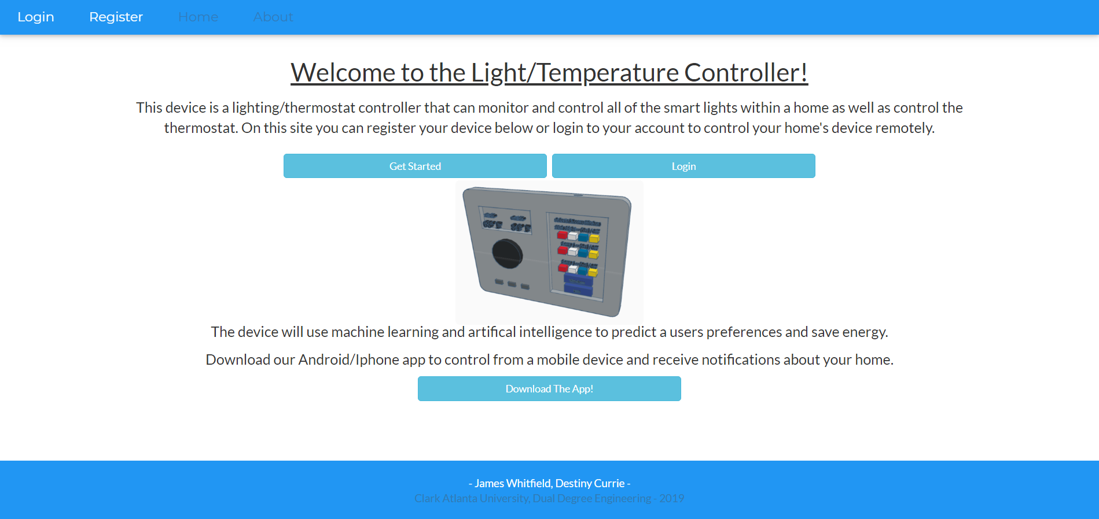

Slide 12
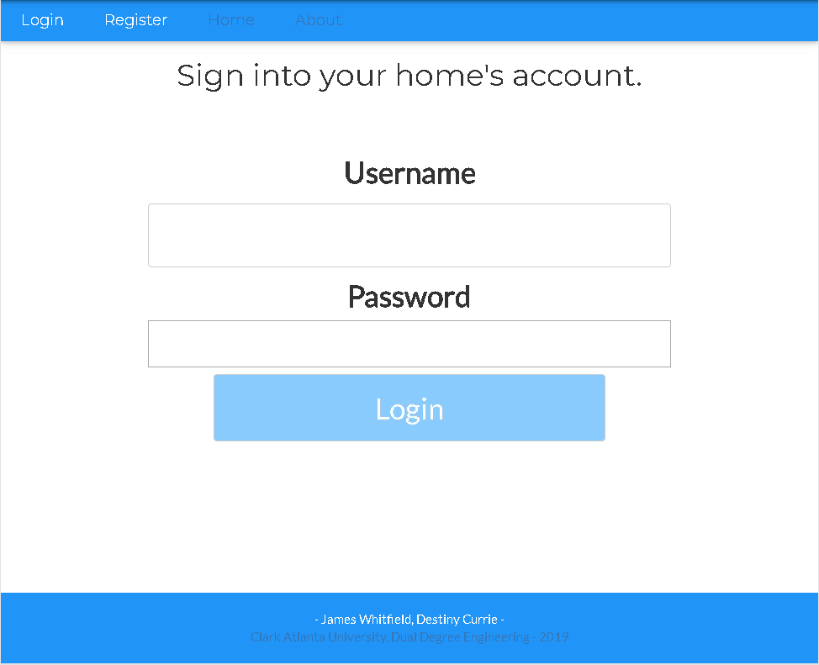
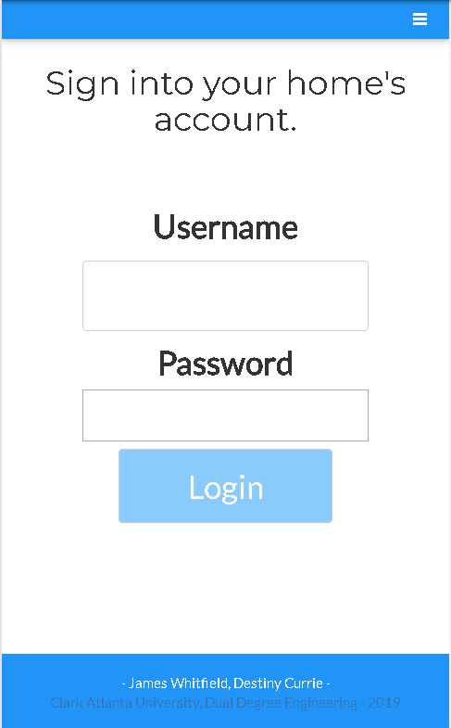

Slide 13
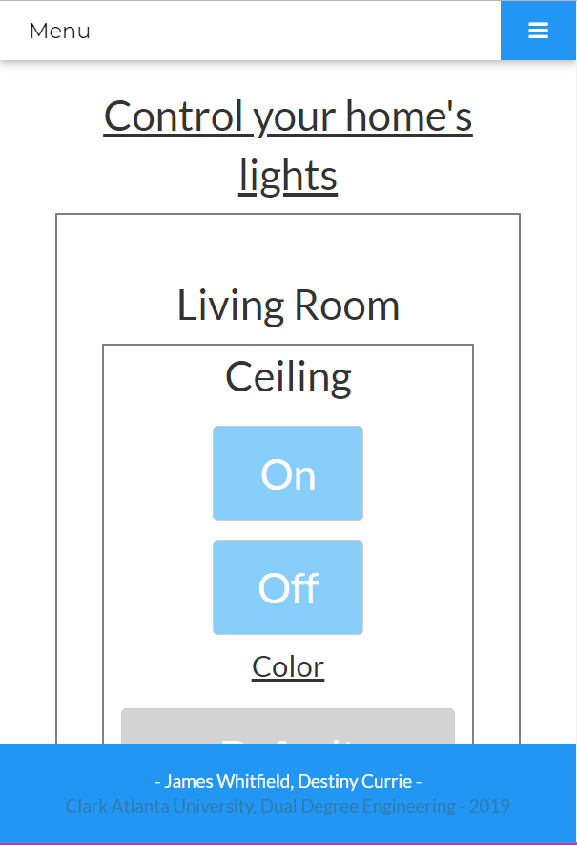
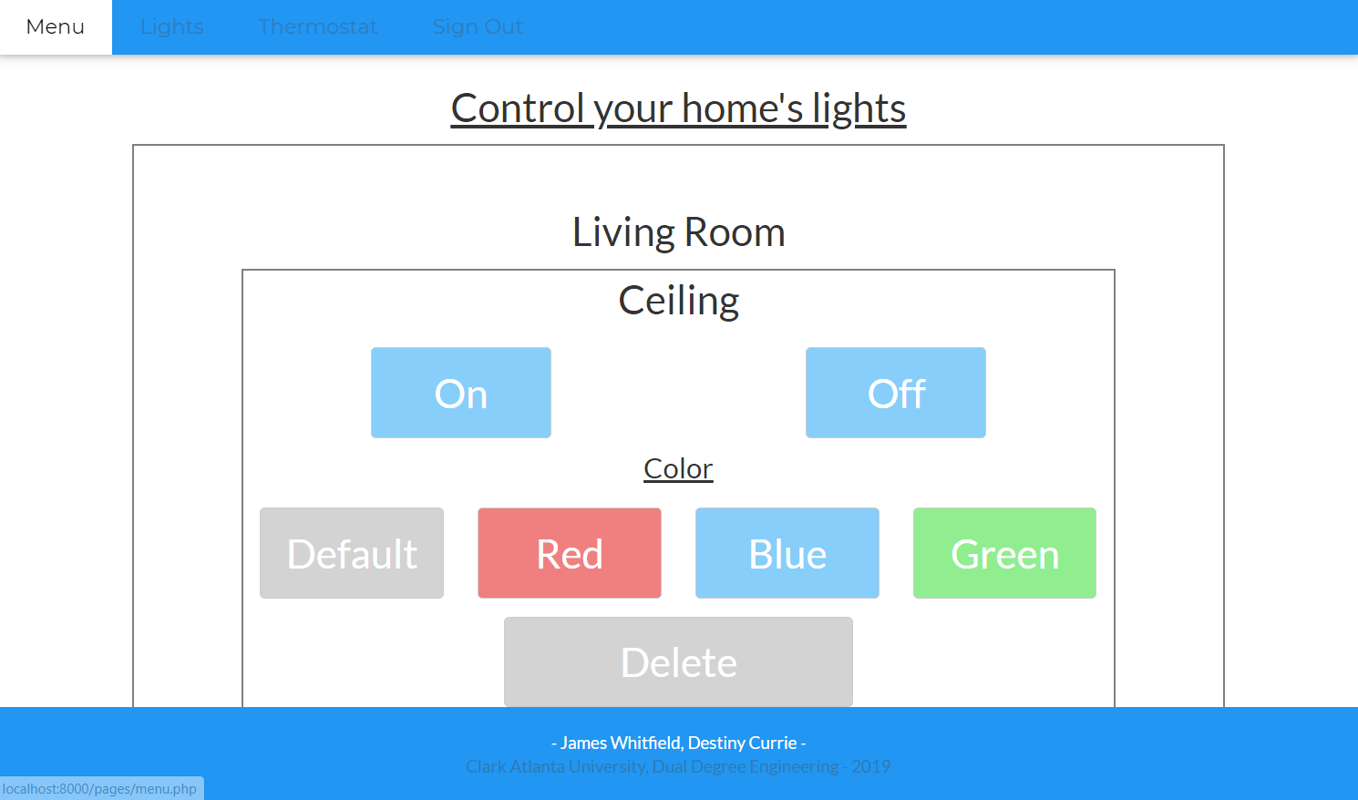

Slide 14
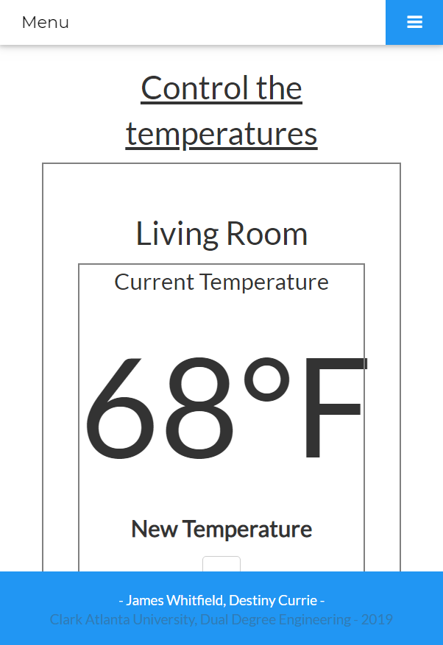
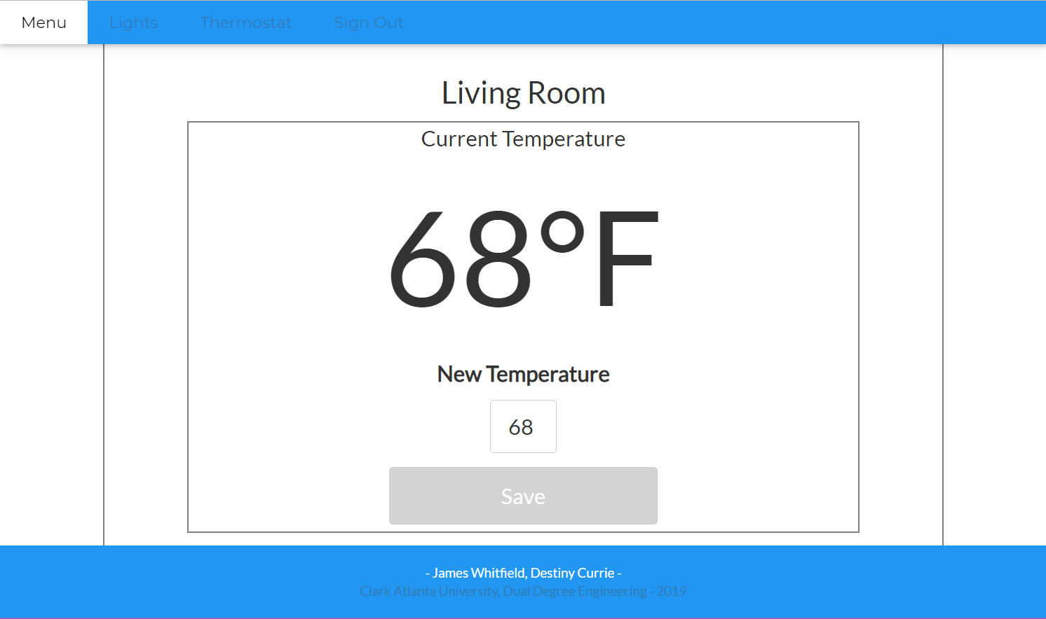

Slide 15
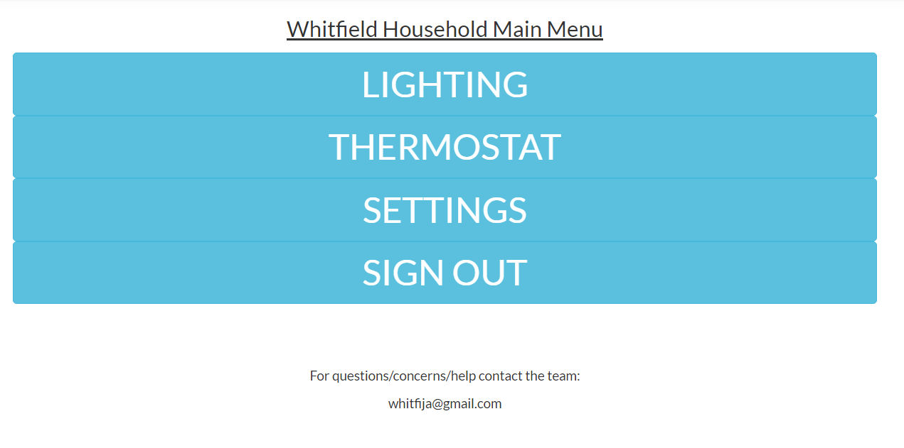
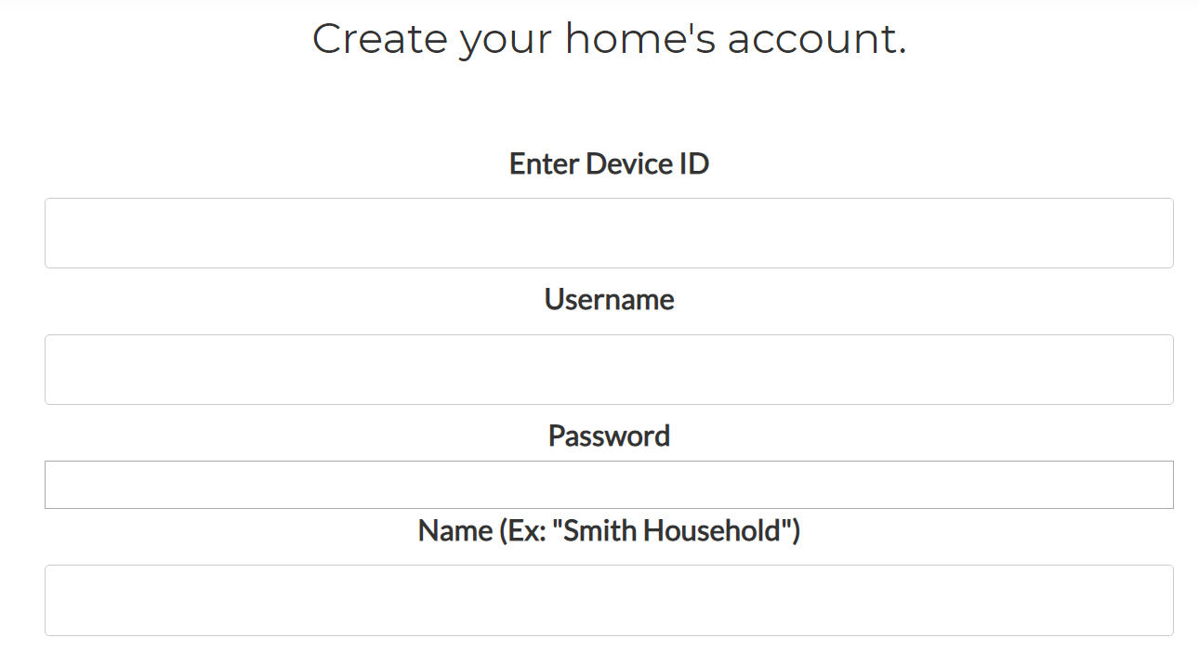
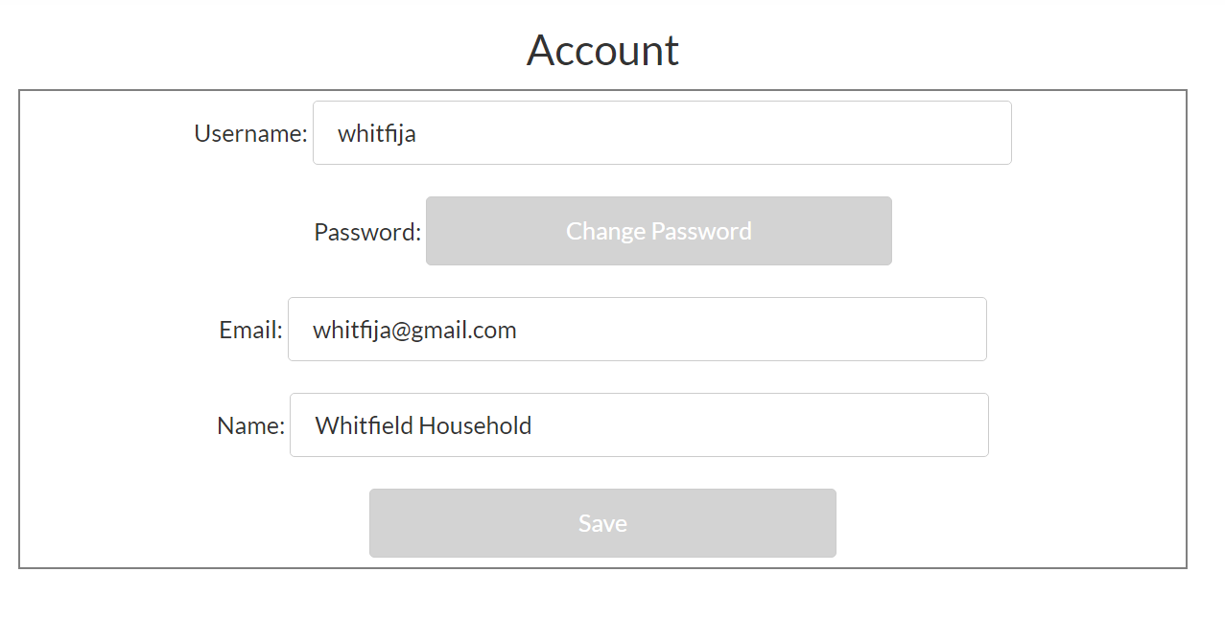
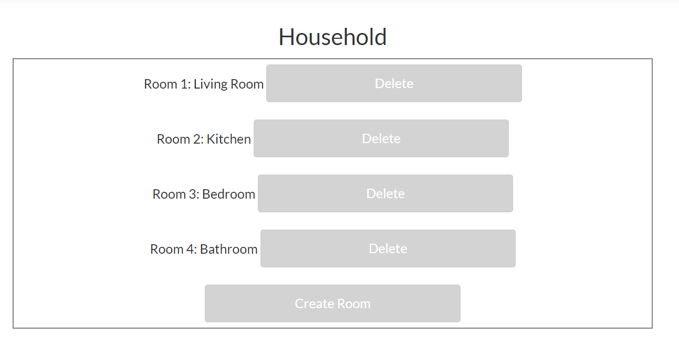

Slide 16
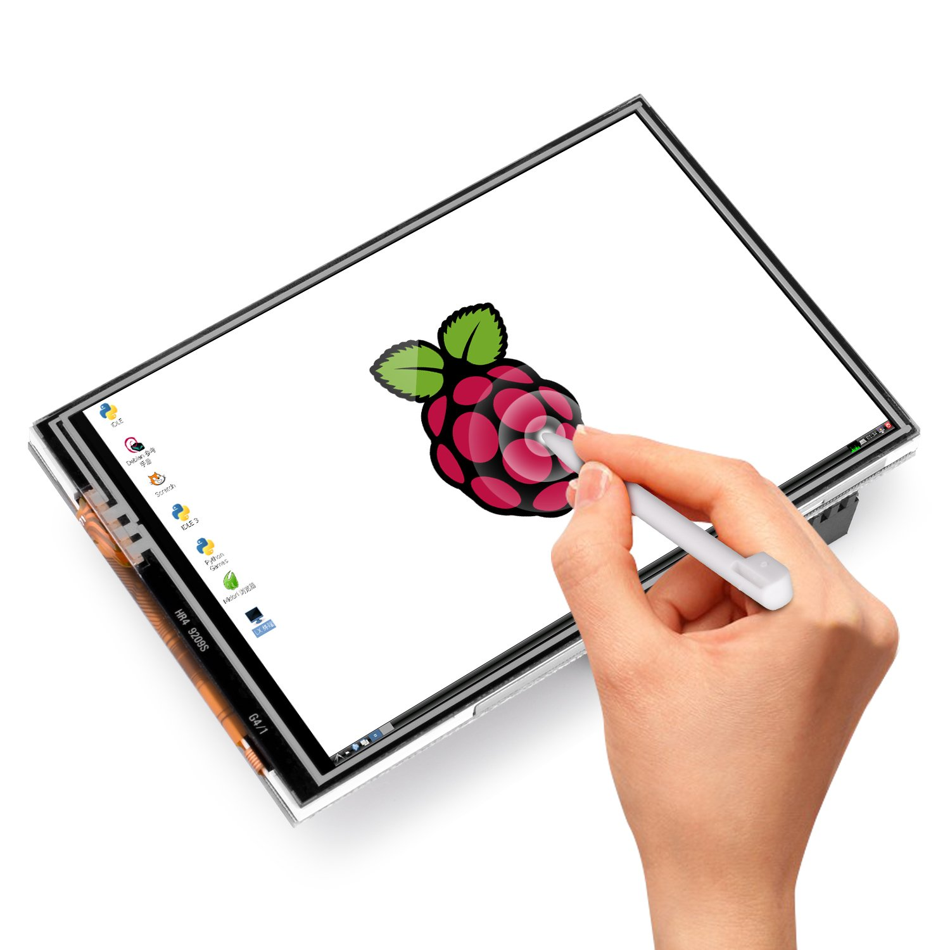
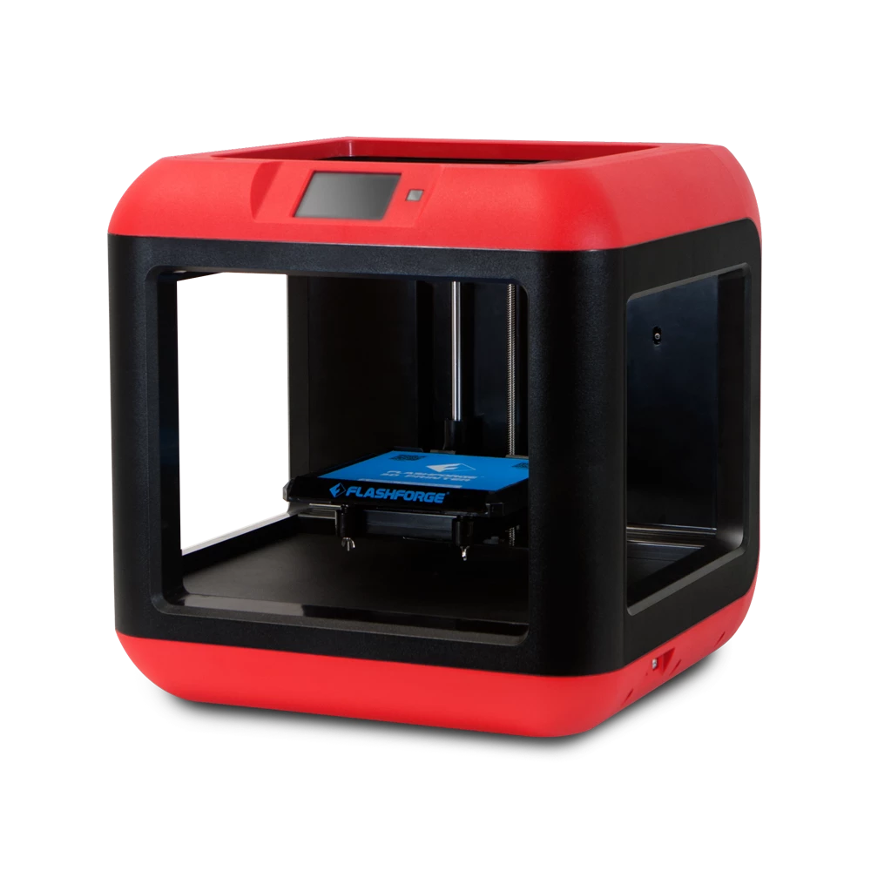
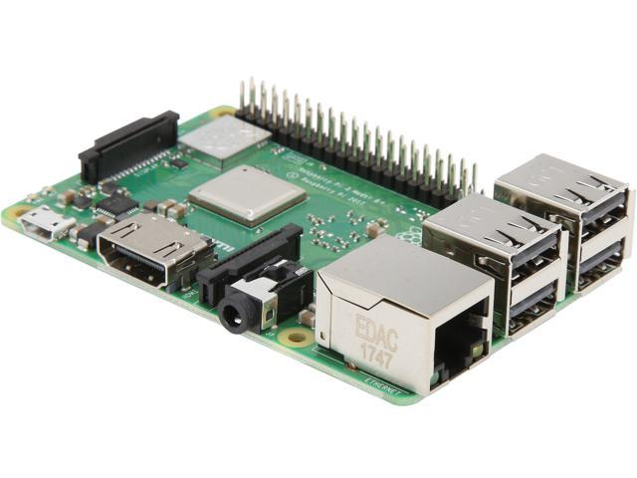
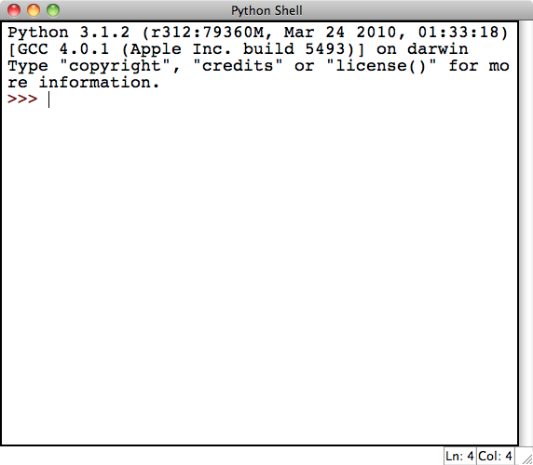
Prototype
3D Printed Shell
Custom built
SolidWorks Model
Raspberry Pi 3 B+
Kuman Touch Screen
Python Application
MySQL
Bluetooth

Slide 17


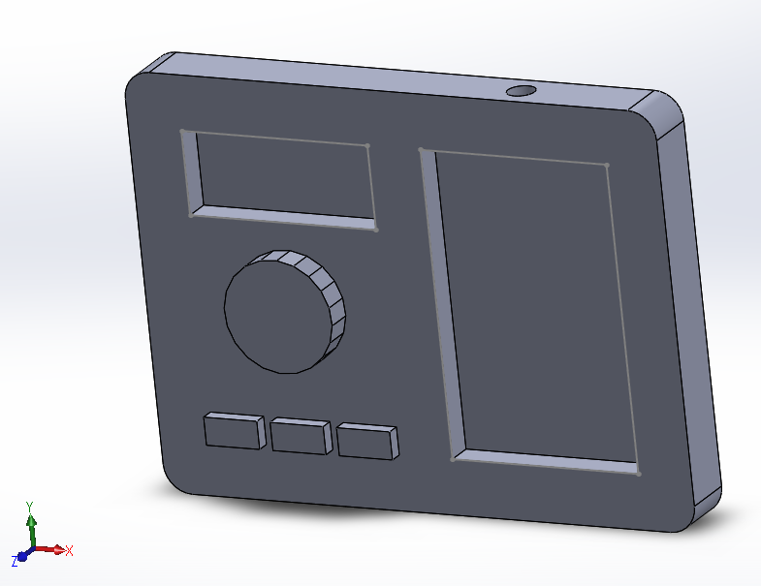
SOLIDWORKS MODEL

Slide 18
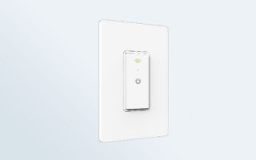
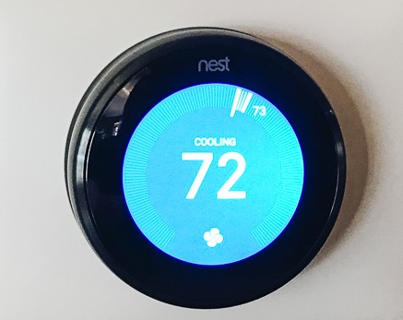
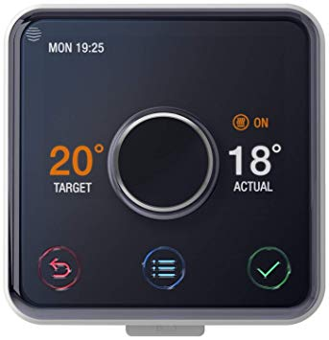
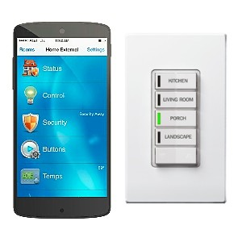
COMPETITORS
Smart Thermostats
Energy efficiency prompts, routine saving
T/L Controller
Machine learning
BT light controls
Web & Mobile
Smart light controllers
Mobile Apps, Real time control
T/L Controller
Fully Digital
Little installation
Compatibility
Web App

Slide 19

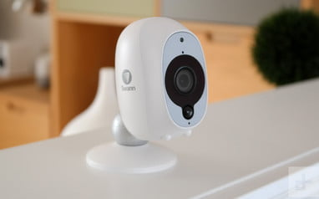
FUTURE ADDITIONS
More smart devices
Fridges, TVs, Cameras, Security
Stats
On both site and app
Graphs, Charts
Energy Usage, On time
Patterns
Design updates
One large display
Smaller controller

Slide 20
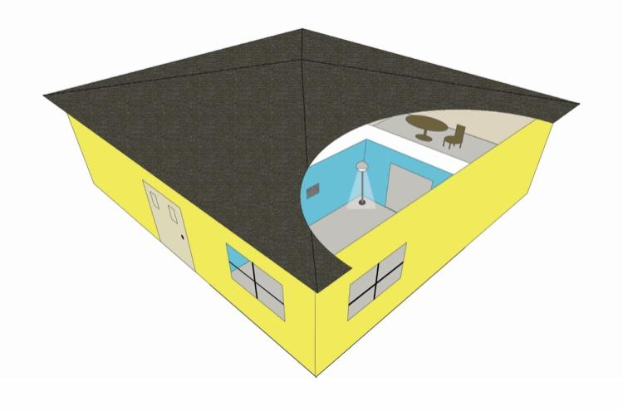

NEXT STEPS
VR Representation
Controllable device
3D modelled home
Walkthrough
Finalize Web App
Refresh Rate
Update Android App
MySQL connectivity
Assemble Prototype
Changes as needed
Documentation
Report
Poster

Slide 21

https://web.ornl.gov/sci/buildings/jump https://jump.ideascale.com
https://www.makeuseof.com/tag/sensors-every-smart-home
https://www.pcmag.com/feature/370629/the-best-smart-home-devices-at-ifa-2019/6
https://www.forbes.com/sites/louiscolumbus/2018/08/16/iot-market-predicted-to-double-by-2021-reaching-520b/#20eb95401f94
https://www.gartner.com/en/newsroom/press-releases/2019-08-29-gartner-says-5-8-billion-enterprise-and-automotive-io
https://www.consumerreports.org/smart-thermostats/nest-learning-thermostat-vs-honeywell-lyric-t5-smart-thermostat-face-off/
References

